Slide 1
What software methodology did I used?
Why did I choose this methodology?
METHODOLOGIES
Traditional methodologies:
Waterfall methodology.
Alterative methodology.
spiral methodology
Advanced methodologies:
Agile development.
Hybrid situation.
Why I used agile methodology?

Slide 2

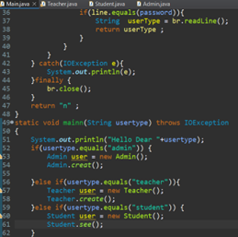
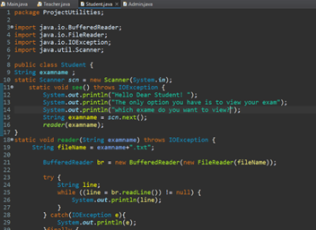
Listing security principles that were developed in my application.
Explaining the benefits for each principle.
Least Privilege
Keep It Simple

Slide 3
Listing two quality principles that were illustrated in my application.
Explaining the benefits for each principle. (with code)
Readability and Capability
Flexibility and Reusability

Slide 4
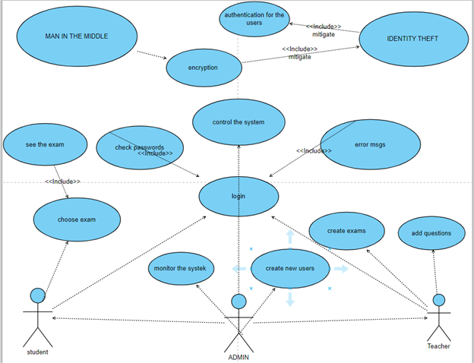
List the assets of the application
Grades
Exams
User Password
User Information
The use case diagram and the misuse case diagram for the application

Slide 5
Two of the misuse cases and list the countermeasures that I used.
Justify the countermeasures chosen.
Identify Fraud/Theft
Man in The Middle

Slide 6
Listing three of the best practices of coding a secure code
Handle Exception
Programming Language
Validate The Request

Slide 7
What dynamic testing techniques did you use? Justify the using of these techniques.
Unit Testing
Integration Testing
System Testing
because it enables developers to detect and solve defects early in the development process, before they become more difficult and costly to fix.
ensures that the various components of a software system operate together as planned.
ensures that a full software system satisfies all its criteria. This approach is critical for assessing the overall quality and functioning of the system, as well as finding any faults that may have gone undetected during unit and integration testing.

Slide 8
THANK YOU
Yazan Khoury

